Slide 1


GRID-X
Department: Computer Science & Artificial Intelligence
Team Members:
Syed Ibrahim Ali (1604-22-748-010)
Faiz Ahmed (1604-22-748-013)
Husamuddin Bilal (1604-22-748-017)
Guide: Uma N Dulhare
College: Muffakham Jah College of Engineering & Technology

Slide 2

ABSTRACT
  GRID-X is an end-to-end machine learning system that predicts lap times, race outcomes, driver styles, and optimal pit strategies for Formula 1.
  Combines supervised, unsupervised, reinforcement, ensemble,transfer learning and computer vision paradigms.
  Uses powerful Supervised learning models to predict laptimes, and race outcomes and unsupervised learning to groups drivers according to driving style.
  Uses more advanced ml paradigms like reinforcement learning to optimise race strategy ,machine vission to analyse circuits and transfer learning to ease training.
  SHAP explainability provides feature-level transparency for lap-time predictions.
  All models are served through a unified FastAPI backend, ready for frontend integration.

Slide 3
EXISTING SYSTEM
  Existing F1 prediction tools are often single-purpose (e.g., only lap-time or only race outcome) and lack transparency.
  Commercial platforms (like some sports betting sites) use basic statistical models or single ML models without multi-paradigm integration.
  No publicly available system combines regression, classification, clustering, reinforcement learning, and computer vision in one platform.
  Most solutions do not provide explainability or strategy optimization; they are “black boxes.”
  Our system addresses these gaps with a comprehensive, multi-paradigm, explainable AI platform.

Slide 4
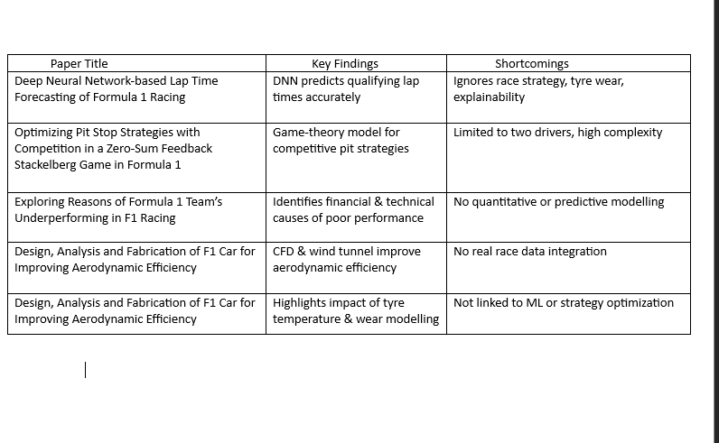
LITERATURE SURVEY

Slide 5
PROPOSED SYSTEM
System Architecture Diagram
  Data Layer: FastF1 API (modern telemetry) + Kaggle historical dataset (1950–2020) → preprocessing pipelines.
  Model Layer:
    Lap-Time Predictor (RandomForest)
    Driver Style Analyzer (KMeans)
    Race Outcome Classifier (Dual-era XGBoost + Logistic Ensemble)
    Pace Forecaster (LSTM)
    Strategy Optimizer (DQN)
    Circuit Analyzer (ResNet50 CNN)
  Integration Layer: int_en_pred_2.py loads all models; provides unified methods.
  API Layer: FastAPI server with six endpoints (/predict, /stint-simulate, /next-lap, /strategy-optimize, /analyze-circuit, /explain-lap).
  Frontend: (Planned) React dashboard

Slide 6
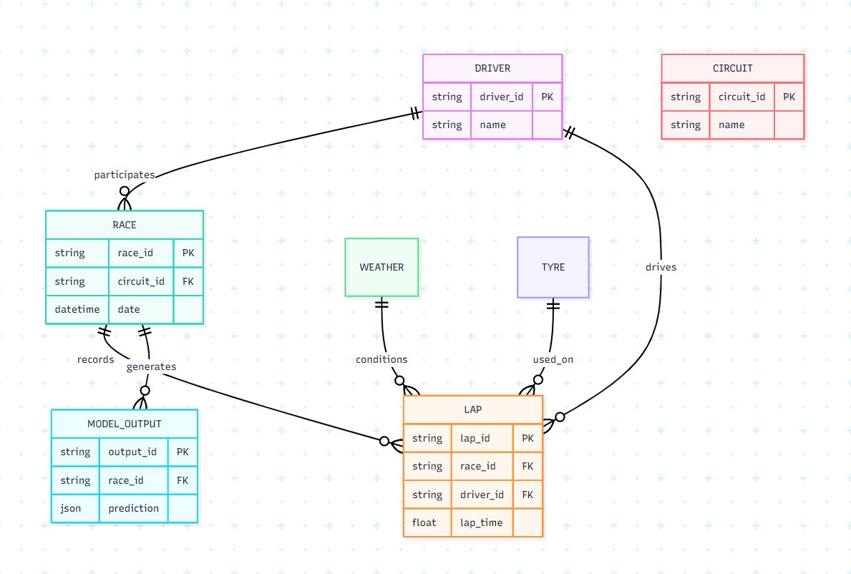
SYSTEM ARCHITECTURE DESIGN
E-R Diagram

Slide 7
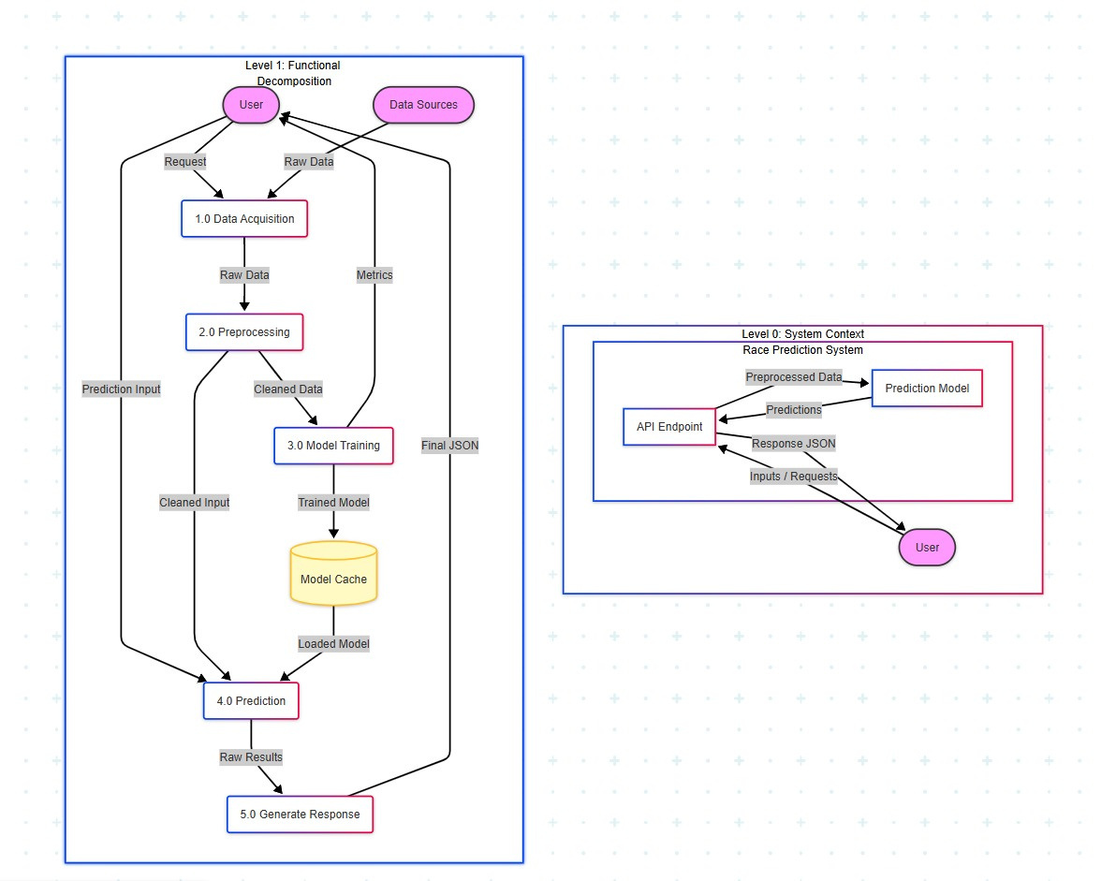
SYSTEM ARCHITECTURE DESIGN
Data Flow Dagrams

Slide 8
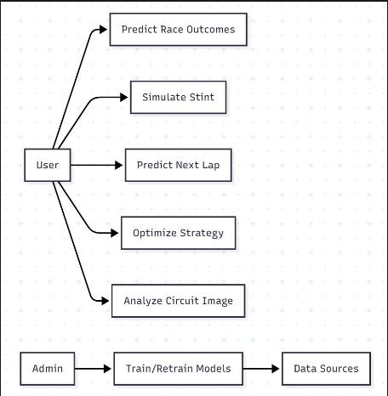
UML DIAGRAMS
Use Case Diagram

Slide 9
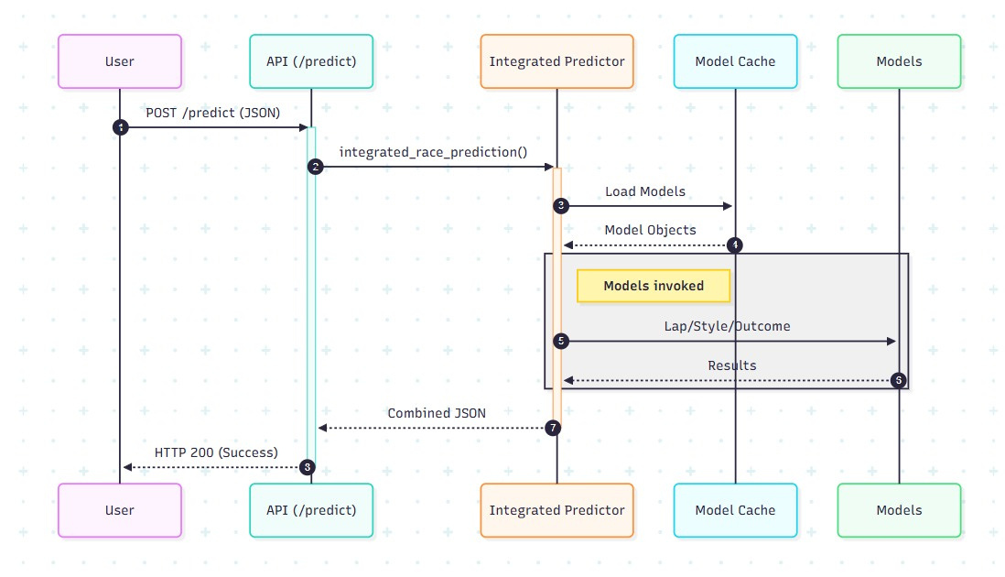
UML DIAGRAMS
Sequence Diagram

Slide 10
METHODOLOGY
1. Lap-Time Prediction (Random Forest)
  Input: 21 features (weather, tyre age, stint progress, circuit, driver…)
  Output: Lap time (seconds)
  Algorithm: Random Forest Regressor with 100 trees; hyperparameter tuning via GridSearch.
  Performance: RMSE = 2.787s, R² = 0.993, MAE = 0.96s.
2. Race Outcome Classification (Dual-era Ensemble)
  Historical model: XGBoost on 1950–2020 data (13 features).
  Modern model: XGBoost on 2021–2024 data (10 features).
  Ensemble: Logistic regression on the two model probabilities.
  Accuracy: Win 96.4%, Podium 93.2%, Points 88.6%.

Slide 11
3. Driver Style Clustering (KMeans)
  Features engineered from telemetry (consistency, aggression, braking, etc.).
  Optimal k=4 (Silhouette score).
  Resulting clusters: Aggressive, Smooth, Opportunistic, Balanced.
4. Reinforcement Learning (DQN)
  Environment: Custom RaceEnv with linear tyre degradation (0.1–0.5 s/lap, compound-specific).
  State: (lap norm, tyre age norm, one-hot compound).
  Actions: Stay out / pit to SOFT / MEDIUM / HARD.
  Reward: Negative lap time (minimize total race time).
  Training: DQN with experience replay, target network, 1000 episodes.
  Result: Learns optimal pit stops (e.g., 4 stops for 78-lap race).

Slide 12
5. Circuit Recognition (CNN)
  Model: ResNet50 pre-trained on ImageNet, fine-tuned on 24 circuit schematic images.
  Data augmentation: rotation, flip, color jitter.
  Output: Top-3 circuit predictions with confidence; embeddings for similarity search.
6. Explainability (SHAP)
  TreeExplainer on RandomForest lap-time model.
  For a given prediction, returns top-10 features with SHAP values (positive/negative impact).

Slide 13
DATASET DESCRIPTION
Modern Data (2021–2024)
  Source: FastF1 API
  Records: 90,901 clean laps
  Features: 57 columns including lap times, sector times, speeds, weather, tyre compound, stint, driver, team.
  Drivers: 34
  Events: 29 race weekends
Historical Data (1950–2020)
  Source: Kaggle F1 Dataset
  Records: 26,759 race entries
  Features: driver, constructor, grid, position, points, year, circuit, etc.
  Drivers: 861
  Constructors: 211
  Circuits: 77

Slide 14
Circuit Image Dataset
  Source: Web scraping + teammate collection
  Images: 24 schematic circuit maps (PNG, 224×224, white background, black track lines)
  Metadata: circuit name, full name, location, track type, length, corners, first GP, lap record, etc.

Slide 15
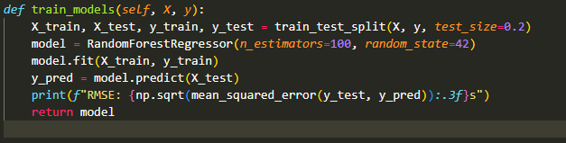
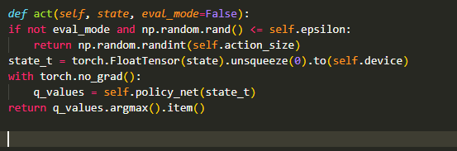
Module Implementation
Code Snippets
Lap-Time Predictor
DQN Agent – Action Selection

Slide 16
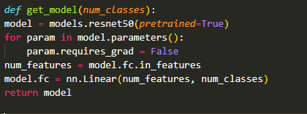
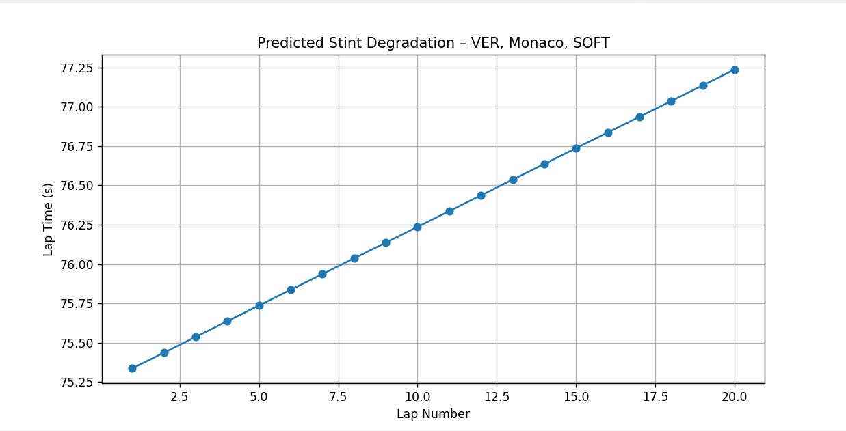
CNN model definition
RESULTS
Stint Degradatiion

Slide 17
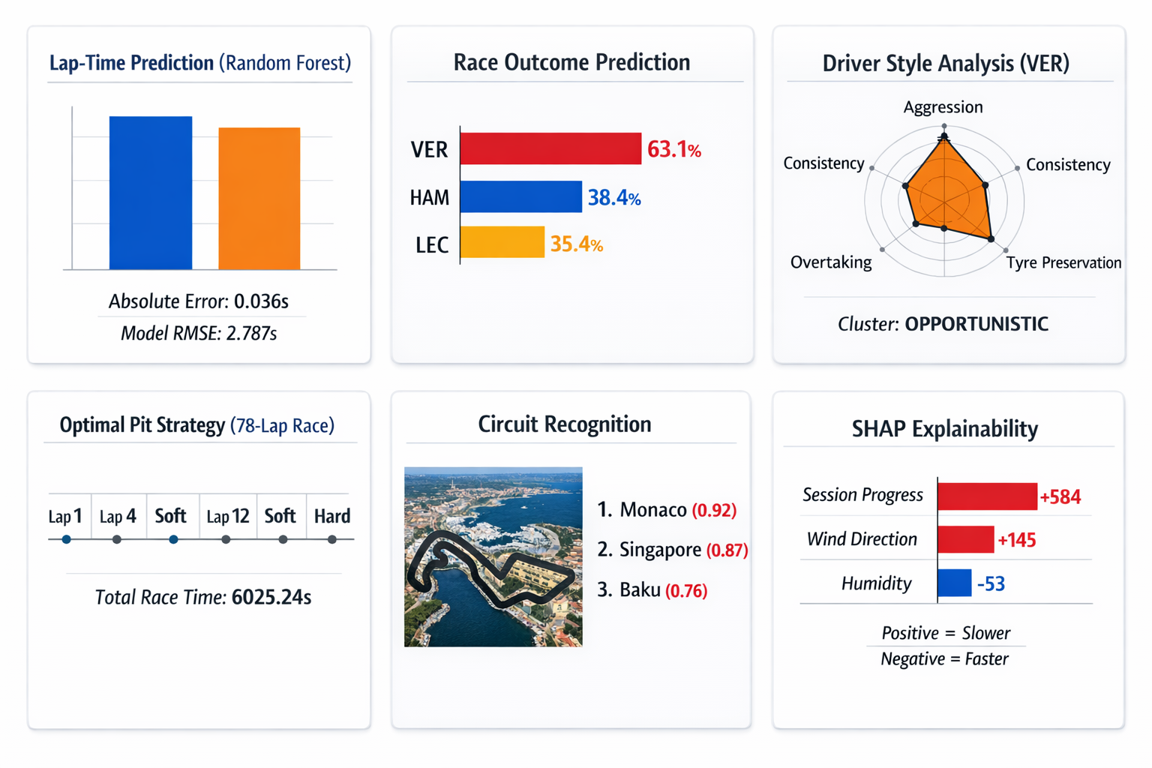

Slide 18
THANK
YOU

